Slide 1
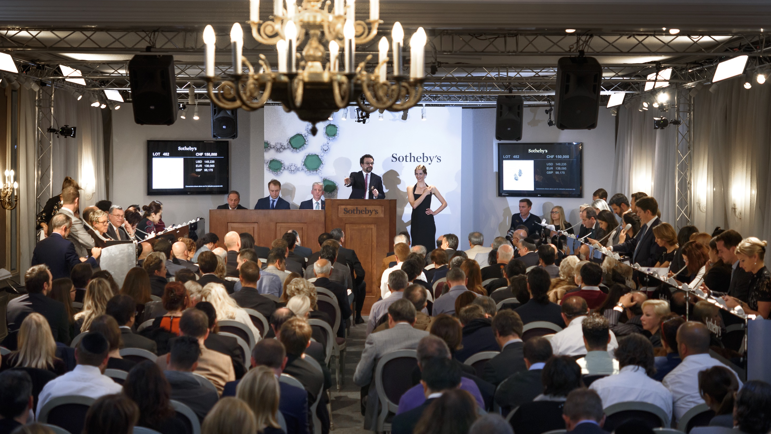
PowerPoint Templates provided by PresentationPoint.com
Software solutions for digital signage and data driven presentations
www.PresentationPoint.com

Slide 2
COPYRIGHT NOTICE:
You are allowed to use these templates in your own organization and modify them as you like. You cannot sell or give them to others. Instead, direct them to PresentationPoint.com to download their own copy.

Slide 3
USING THIS TEMPLATE FOR DIGITAL SIGNAGE?
Check out iPoint
THE POWERPOINT DIGITAL SIGNAGE SOLUTION

Slide 4
NEED TO CONNECT THIS TEMPLATE TO DATA?
Check out DataPoint
OUR POWERPOINT
ADD-ON FOR DATA

Slide 5
WANT TO ADD WEATHER AND NEWS TO YOUR TEMPLATE?
Try Dynamic Elements
POWERPOINT ADD-ON
FOR NEWS AND WEATHER

Slide 6
WANT TIMERS & CLOCKS
ON YOUR TEMPLATE?
Try Dynamic Time
POWERPOINT ADD-ON FOR CLOCKS, TIMERS AND COUNTDOWNS

Slide 7
Presentation Schedule
Date
Time
Room
Speaker
Research Area
5/11/2022 | 10:00 AM 12:00 PM | A 102 | G. Johnson | Medical Physics
5/11/2022 | 12:30 PM 03:00 PM | Auditory | K. Morrison | Space and Plasma Physics
5/11/2022 | 02:00 PM 05:00 PM | A 100 | T. Baker | Astronomy and Astrophysics
5/12/2022 | 09:00 AM 12:30 PM | A 102 | C. Bryan | General Relativity
5/12/2022 | 04:00 PM 07:00 PM | Auditory | A. Cooper | AMO Physics
5/13/2022 | 10:30 AM 02:00 PM | A 102 | L. Malcolm | Medical Physics
5/13/2022 | 02:00 PM 05:00 PM | A 100 | G. Kim-Lee | Astronomy and Astrophysics
Update your schedule in real-time with DataPoint
You can remove this note

Slide 8
Today’s Schedule
Class
Instructor
Room
AAB/100 | G. Kim-Lee | 110
ACC/131 | V. Morrison | 105
AEG/120 | D. Goldman | 102
CIS/319 | A. Williams | 112
LAW/101 | G. Johnson | 103
ORG/501 | C. Bryan | 106
PHD/108 | T. Baker | 116
PHL/204 | A. Cooper | 108
Update your schedule in real-time with DataPoint
You can remove this note

Slide 9
Upcoming Classes
TODAY
Space and Plasma Physics
Sunday, May 11, 2022
09:00 AM
10:00 AM
AMO Physics
Sunday, May 11, 2022
09:00 AM
10:30 AM
Astronomy and Astrophysics
Update your schedule in real-time with DataPoint
You can remove this note
Sunday, May 11, 2022
09:00 AM
11:00 AM
Medical Physics
Sunday, May 11, 2022
01:30 PM
04:00 PM
* Make sure you have entries for today in your database (table TableUpcomingClasses) as this data is filtered.

Slide 10
Upcoming Classes
Sunday, May 11, 2022
TODAY
Space and Plasma Physics
Sunday, May 11, 2022
09:00 AM
10:00 AM
AMO Physics
Update your schedule in real-time with DataPoint
You can remove this note
Sunday, May 11, 2022
09:00 AM
10:30 AM
Astronomy and Astrophysics
Sunday, May 11, 2022
09:00 AM
11:00 AM
Medical PhysicsMedical Physics
Sunday, May 11, 2022
01:30 PM
04:00 PM
* Make sure you have entries for today in your database (table TableUpcomingClasses) as this data is filtered.
Campus News
Physicists address shortage in qualified science teachers
Science education in the United States is at a critical point, according to a national group of physicists and educators.

Slide 11
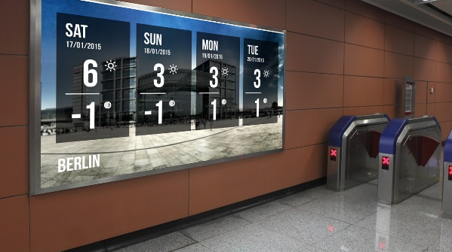
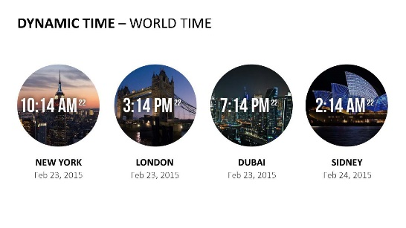
Do More With PresentationPoint Products
Real-time weather and forecasts
Add a clock or countdown to your presentations
Live RSS feed in your PowerPoint
Notes:
11

