Slide 1
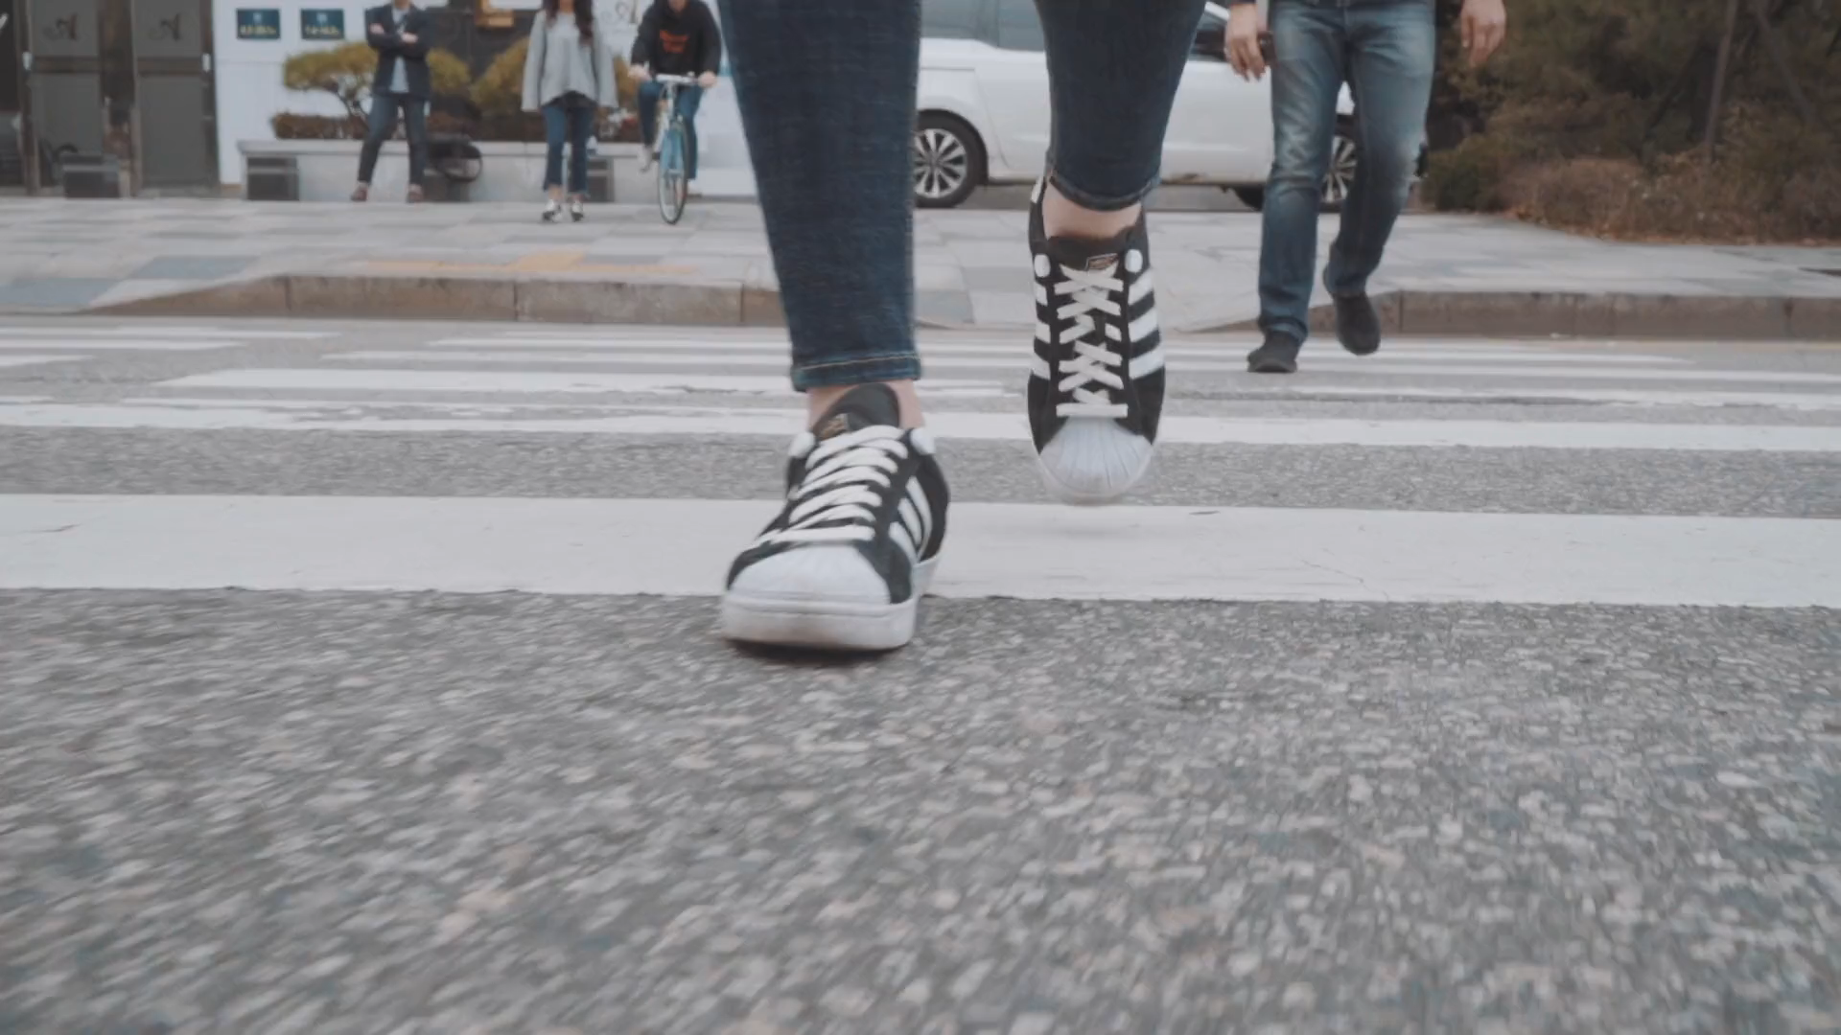
Explore Stockholm by foot
GET YOUR CITYMAP
€19.00
INCLUDES
FREE
HOP-ON HOP-OFF BUS

