Slide 1
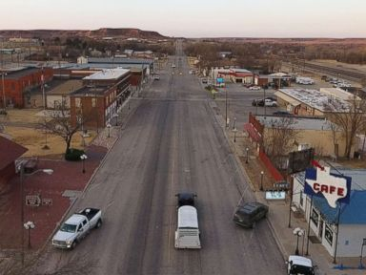
Roberts County: A year in the most pro-Trump town in America
A place where Buddy the dog barks like mad whenever he hears Hillary.
Politics

