Slide 1
IT WILL START SOON…

Slide 2
ONE MOMENT PLEASE….

Slide 3
HERE WE GO!

Slide 4
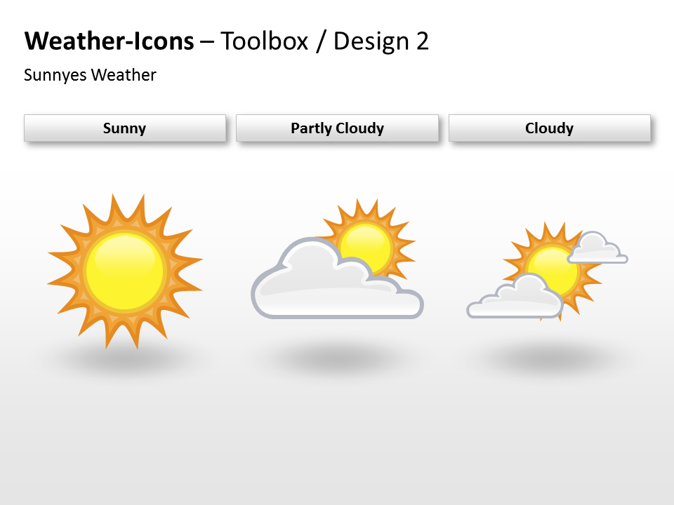
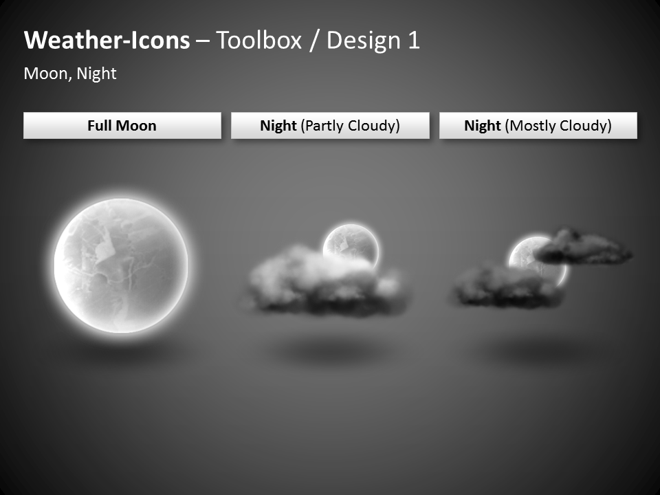

Slide 6
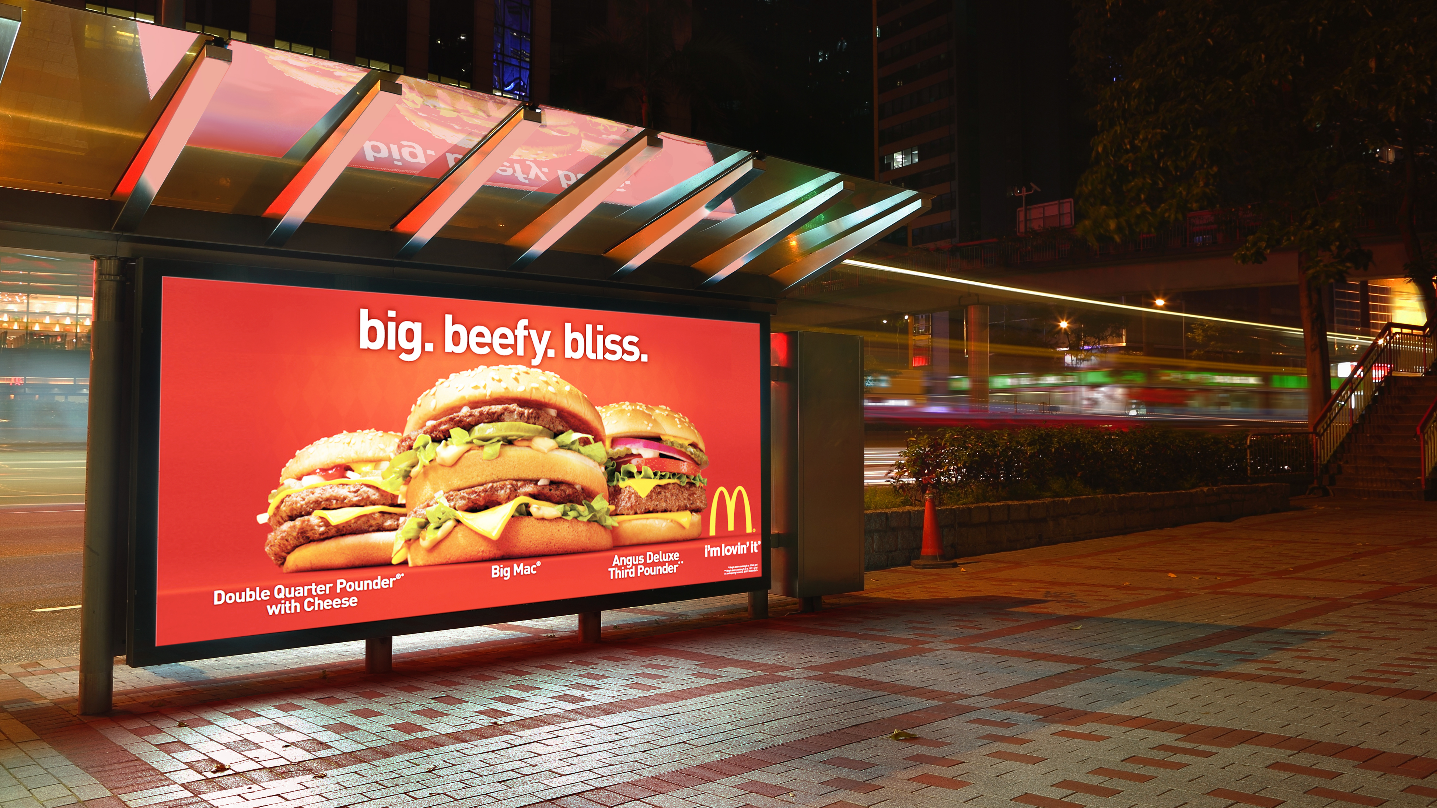

Slide 7
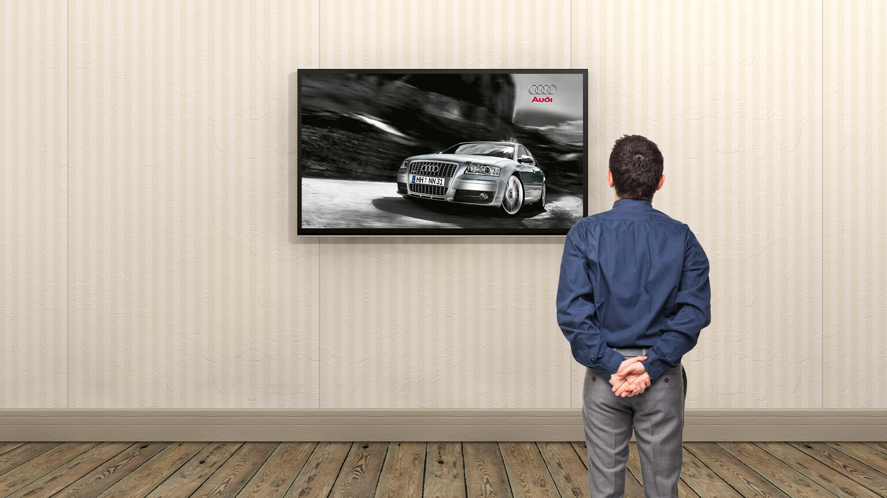
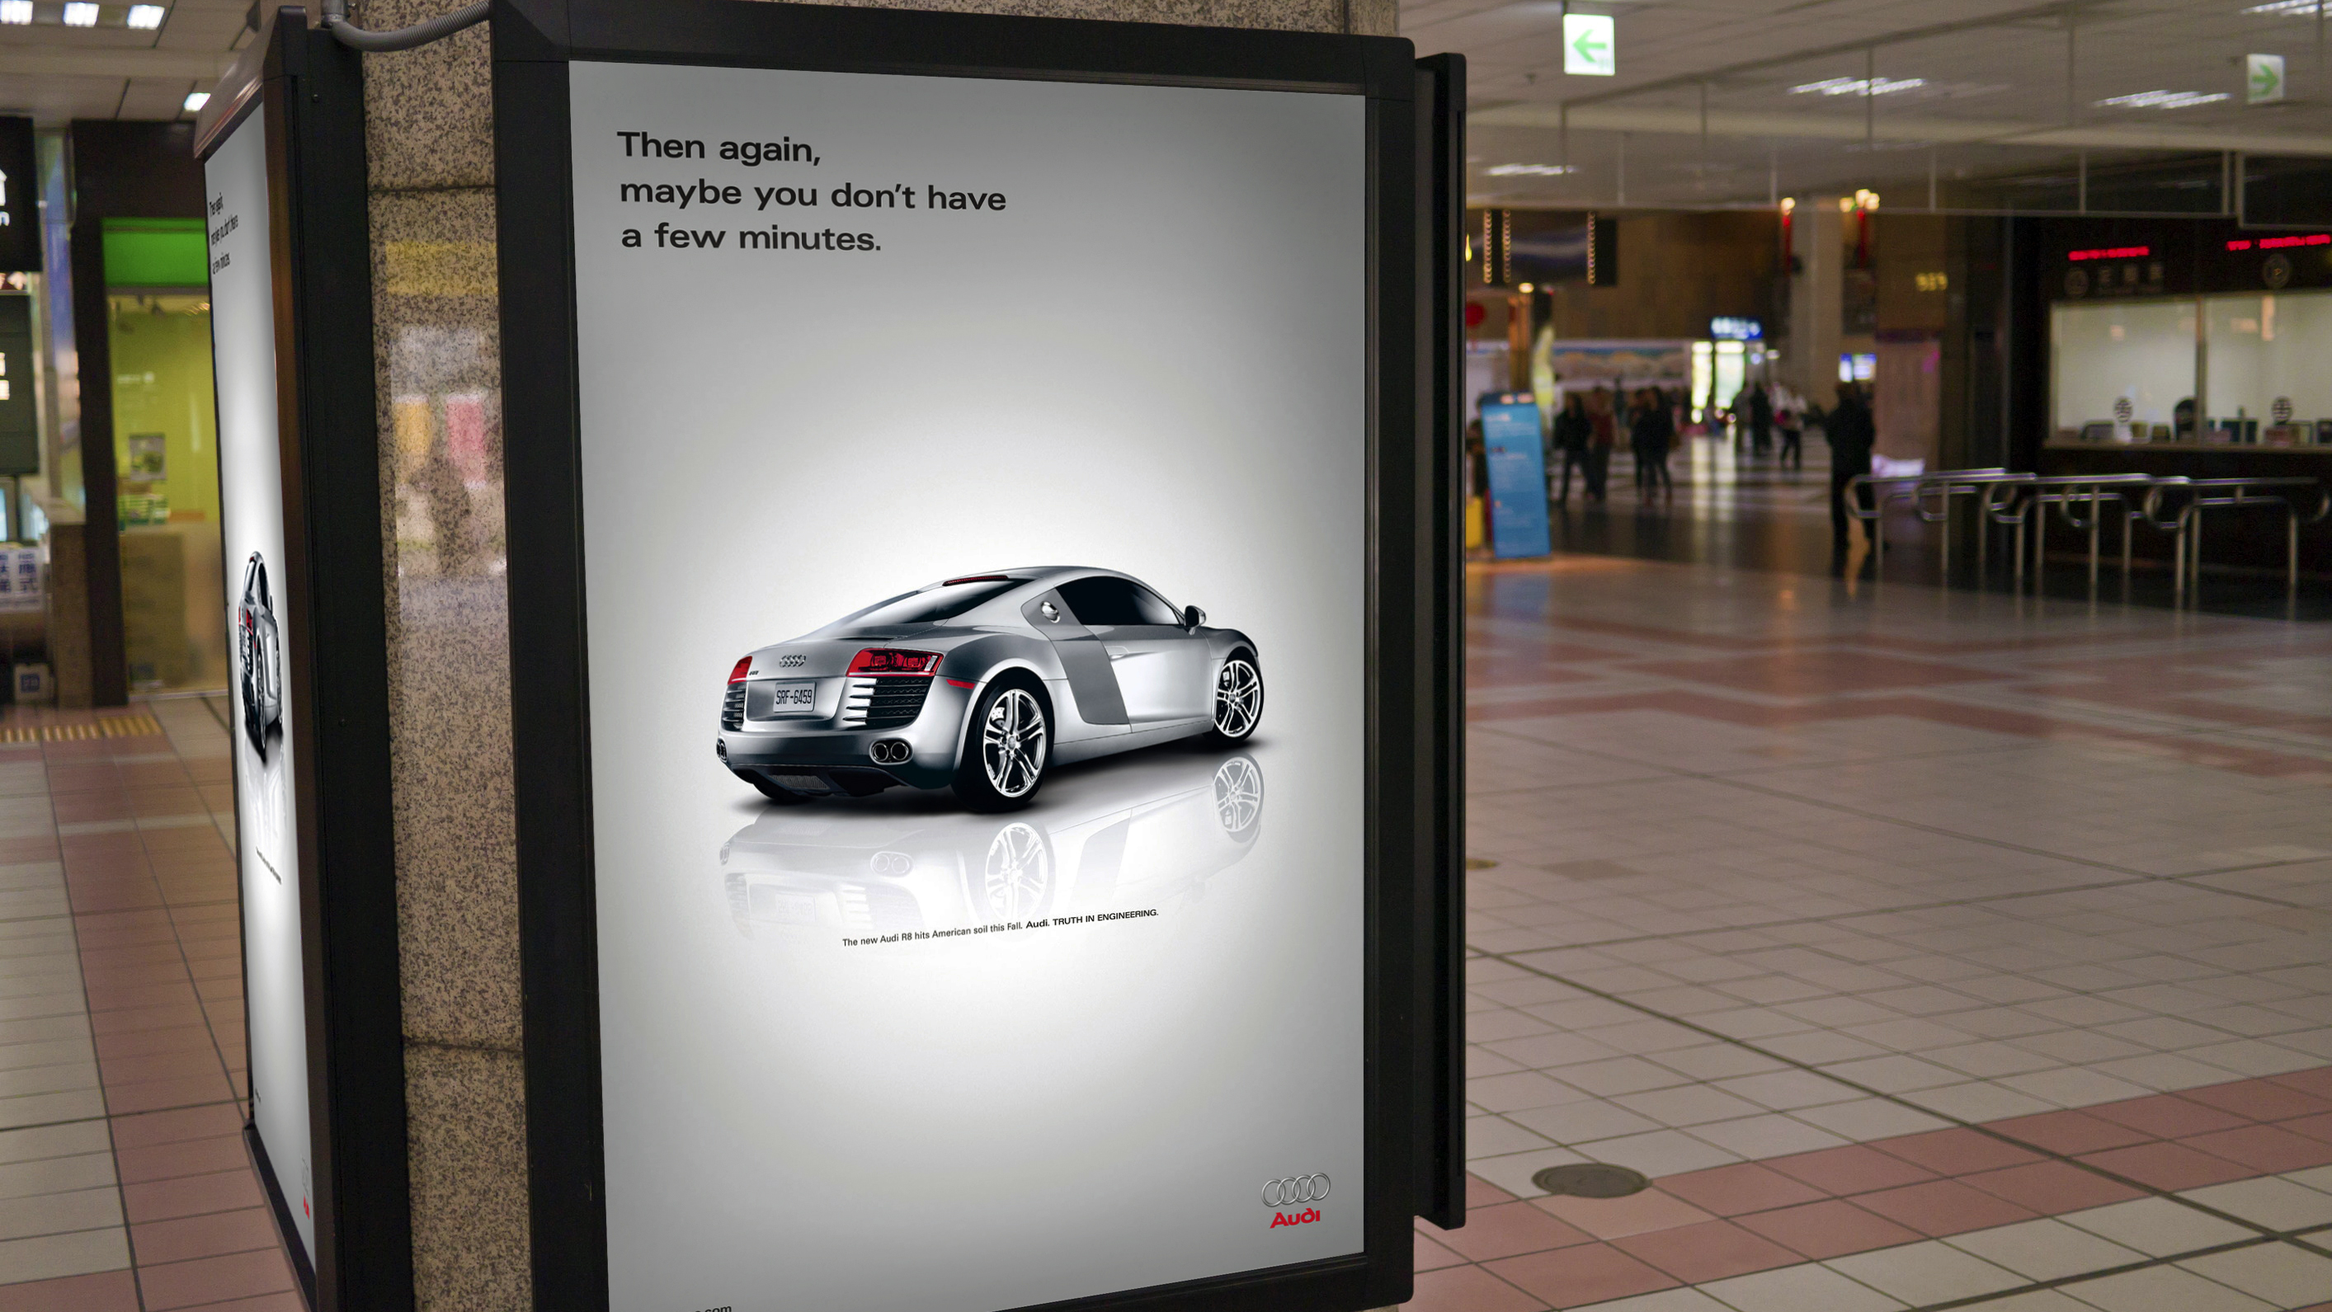

Slide 8
